Slide 1
4차산업혁명의이해 6DoF Pose 시각화
4차산업혁명의이해
한림대학교
이름: 정수연
학번: 20173733

Slide 2
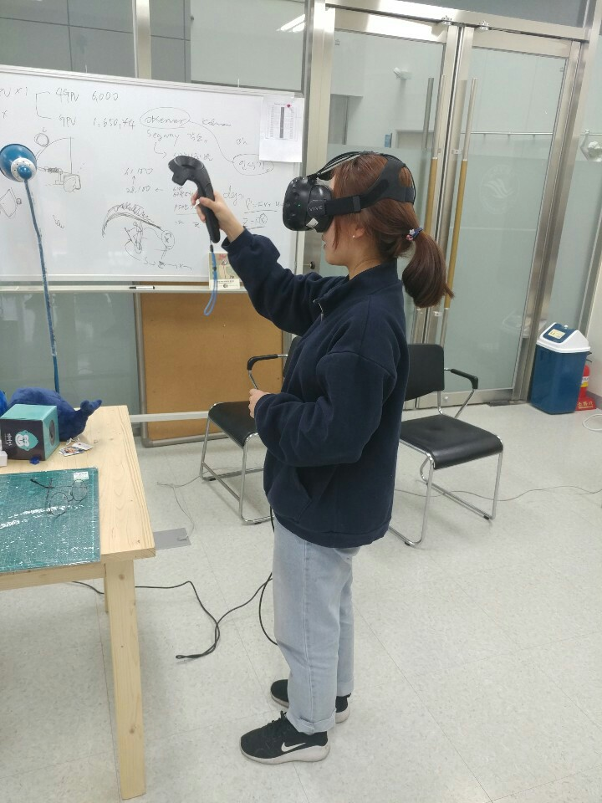
요약
Data 생성 장소 및 일시
산학협력관 # 204호 Intelligent Robotics Lab.
2018/12/5
정수연/환경생명공학과/20173733
조원이 찍어준 자신의 사진을 넣어주세요

Slide 3
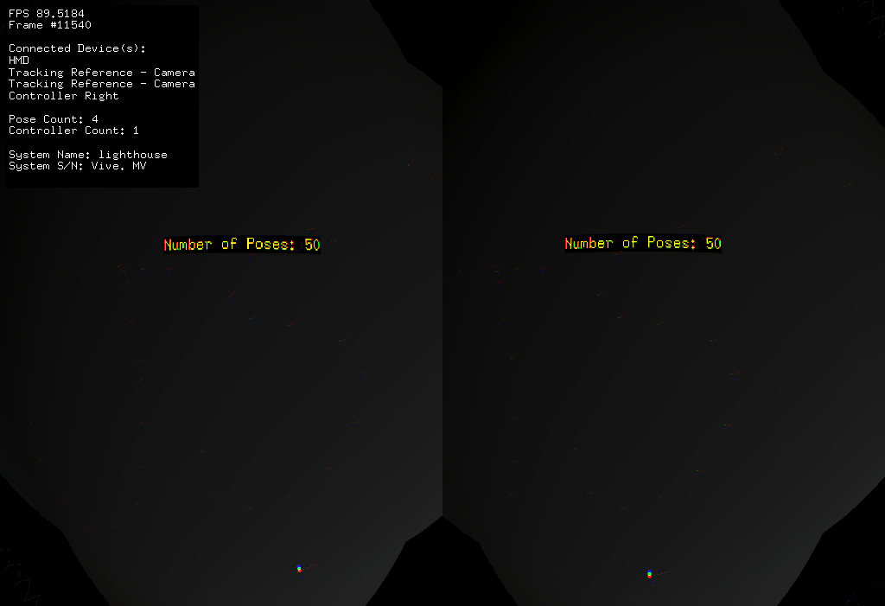
Data #1
컨셉 : ‘JSY(이름 초성)’을 공간에 그리고자 하였다

Slide 4
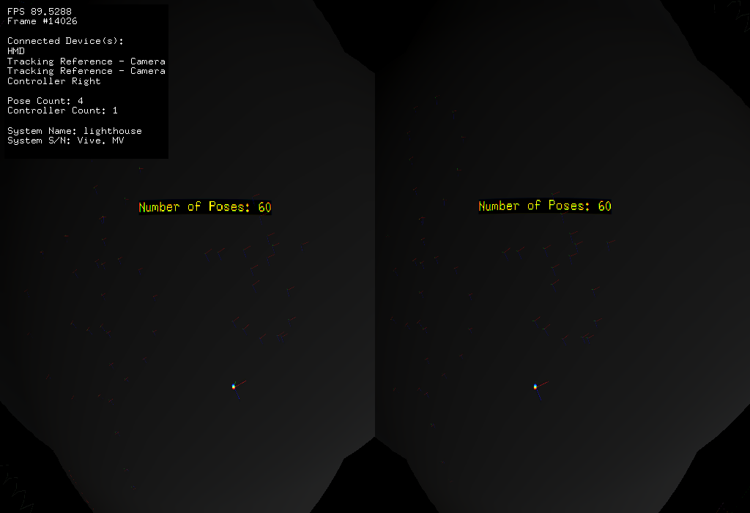

Data #2
컨셉 : ‘높은음자리표( )’와 ‘ㅎ’ 를 공간에 그리고자 하였다

Slide 5
Data #1 – Validation : 각 축들이 서로 수직임을 확인
 | x축 |  |  |  | y축 |  |  |  | z축 |  |  |  | transtlation
x | y | z |  | x | y | z |  | x | y | z |  | x | y | z |  |  | 곱(x축과 y축) | 곱(y축과 z축) | 곱(z축과 x축)
0.103207 | 0.708368 | 0.698258 | 0 | -0.93796 | -0.16433 | 0.305341 | 0 | 0.331035 | -0.68645 | 0.647459 | 0 | 0.624242 | 1.629995 | -0.24979 | 1 |  | 0.00 | 0.00 | 0.00
0.082969 | 0.540068 | 0.837522 | 0 | -0.97461 | -0.13142 | 0.181296 | 0 | 0.207981 | -0.8313 | 0.51545 | 0 | 0.657438 | 1.647981 | -0.21397 | 1 |  | 0.00 | 0.00 | 0.00
0.029624 | 0.390614 | 0.920078 | 0 | -0.98867 | -0.12406 | 0.084503 | 0 | 0.147155 | -0.91216 | 0.382513 | 0 | 0.684109 | 1.667408 | -0.14052 | 1 |  | 0.00 | 0.00 | 0.00
-0.09066 | 0.348245 | 0.933009 | 0 | -0.98565 | -0.16532 | -0.03407 | 0 | 0.142382 | -0.92271 | 0.358236 | 0 | 0.699081 | 1.669845 | -0.08783 | 1 |  | 0.00 | 0.00 | 0.00
-0.1499 | 0.246211 | 0.957554 | 0 | -0.98021 | -0.16363 | -0.11138 | 0 | 0.129266 | -0.9553 | 0.265869 | 0 | 0.704311 | 1.675385 | -0.03193 | 1 |  | 0.00 | 0.00 | 0.00
-0.0947 | 0.37635 | 0.921625 | 0 | -0.98057 | -0.19501 | -0.02113 | 0 | 0.171773 | -0.90572 | 0.387506 | 0 | 0.660519 | 1.653835 | -0.12744 | 1 |  | 0.00 | 0.00 | 0.00
-0.10149 | 0.357682 | 0.928312 | 0 | -0.98585 | -0.16134 | -0.04562 | 0 | 0.133453 | -0.9198 | 0.368993 | 0 | 0.675241 | 1.637339 | -0.12406 | 1 |  | 0.00 | 0.00 | 0.00
-0.03761 | 0.377934 | 0.925068 | 0 | -0.9983 | -0.05551 | -0.01791 | 0 | 0.044578 | -0.92417 | 0.379378 | 0 | 0.698651 | 1.580917 | -0.10975 | 1 |  | 0.00 | 0.00 | 0.00
-0.01777 | 0.360536 | 0.932576 | 0 | -0.99938 | 0.021919 | -0.02752 | 0 | -0.03036 | -0.93249 | 0.359924 | 0 | 0.707449 | 1.514869 | -0.09437 | 1 |  | 0.00 | 0.00 | 0.00
0.012032 | 0.384568 | 0.923018 | 0 | -0.99557 | 0.0907 | -0.02481 | 0 | -0.09326 | -0.91863 | 0.383955 | 0 | 0.717717 | 1.481164 | -0.09467 | 1 |  | 0.00 | 0.00 | 0.00
0.070162 | 0.386078 | 0.919794 | 0 | -0.96813 | 0.248579 | -0.03049 | 0 | -0.24041 | -0.88834 | 0.391215 | 0 | 0.734332 | 1.404752 | -0.09302 | 1 |  | 0.00 | 0.00 | 0.00
0.134476 | 0.433587 | 0.891021 | 0 | -0.92902 | 0.36798 | -0.03886 | 0 | -0.34473 | -0.82255 | 0.452296 | 0 | 0.730674 | 1.321815 | -0.107 | 1 |  | 0.00 | 0.00 | 0.00
0.189582 | 0.495393 | 0.847729 | 0 | -0.87607 | 0.475196 | -0.08177 | 0 | -0.44335 | -0.72717 | 0.524088 | 0 | 0.720842 | 1.249369 | -0.12583 | 1 |  | 0.00 | 0.00 | 0.00
0.412845 | 0.54628 | 0.728791 | 0 | -0.84863 | 0.521278 | 0.089996 | 0 | -0.33074 | -0.65563 | 0.678796 | 0 | 0.676073 | 1.214397 | -0.18516 | 1 |  | 0.00 | 0.00 | 0.00
0.52645 | 0.594536 | 0.607764 | 0 | -0.84188 | 0.464329 | 0.275021 | 0 | -0.11869 | -0.65645 | 0.744974 | 0 | 0.625156 | 1.231116 | -0.24309 | 1 |  | 0.00 | 0.00 | 0.00
0.526846 | 0.637369 | 0.562312 | 0 | -0.84731 | 0.341589 | 0.406681 | 0 | 0.067126 | -0.69071 | 0.720011 | 0 | 0.592689 | 1.283159 | -0.28955 | 1 |  | 0.00 | 0.00 | 0.00

Slide 6
Data #2 – Validation : 각 축들이 서로 수직임을 확인
 | x축 |  |  |  | y축 |  |  |  | z축 |  |  |  | transtlation
x | y | z |  | x | y | z |  | x | y | z |  | x | y | z |  |  | 곱(x축과 y축) | 곱(y축과 z축) | 곱(z축과 x축)
-0.0765 | 0.501612 | 0.861704 | 0 | -0.881 | 0.370681 | -0.29399 | 0 | -0.46689 | -0.78165 | 0.413563 | 0 | 0.451412 | 1.355556 | 0.009829 | 1 |  | 0.00 | 0.00 | 0.00
-0.02151 | 0.562894 | 0.826249 | 0 | -0.89271 | 0.361269 | -0.26936 | 0 | -0.45012 | -0.74339 | 0.494731 | 0 | 0.46527 | 1.350839 | -0.02112 | 1 |  | 0.00 | 0.00 | 0.00
0.020093 | 0.599464 | 0.80015 | 0 | -0.91689 | 0.330145 | -0.22432 | 0 | -0.39864 | -0.72914 | 0.556275 | 0 | 0.475816 | 1.366477 | -0.05811 | 1 |  | 0.00 | 0.00 | 0.00
-0.16219 | 0.514179 | 0.842208 | 0 | -0.94311 | 0.170274 | -0.28557 | 0 | -0.29024 | -0.84061 | 0.457311 | 0 | 0.484366 | 1.461573 | -0.03687 | 1 |  | 0.00 | 0.00 | 0.00
-0.27713 | 0.412939 | 0.86757 | 0 | -0.91427 | 0.164333 | -0.37027 | 0 | -0.29547 | -0.89581 | 0.331996 | 0 | 0.474197 | 1.479422 | 0.019022 | 1 |  | 0.00 | 0.00 | 0.00
-0.38099 | 0.337138 | 0.860922 | 0 | -0.8703 | 0.183586 | -0.45703 | 0 | -0.31214 | -0.92338 | 0.223467 | 0 | 0.457325 | 1.482412 | 0.076088 | 1 |  | 0.00 | 0.00 | 0.00
-0.46171 | 0.295213 | 0.836463 | 0 | -0.81249 | 0.237637 | -0.53235 | 0 | -0.35593 | -0.92541 | 0.130137 | 0 | 0.438141 | 1.458392 | 0.123798 | 1 |  | 0.00 | 0.00 | 0.00
-0.51154 | 0.292657 | 0.807888 | 0 | -0.73745 | 0.333043 | -0.58758 | 0 | -0.44102 | -0.89635 | 0.045457 | 0 | 0.422073 | 1.39946 | 0.155869 | 1 |  | 0.00 | 0.00 | 0.00
-0.44574 | 0.355125 | 0.821707 | 0 | -0.67903 | 0.464004 | -0.56888 | 0 | -0.5833 | -0.81153 | 0.034316 | 0 | 0.423537 | 1.322786 | 0.148807 | 1 |  | 0.00 | 0.00 | 0.00
-0.33061 | 0.411942 | 0.849117 | 0 | -0.65746 | 0.544949 | -0.52037 | 0 | -0.67709 | -0.7303 | 0.090668 | 0 | 0.434452 | 1.265239 | 0.11638 | 1 |  | 0.00 | 0.00 | 0.00
-0.17115 | 0.441295 | 0.880891 | 0 | -0.66886 | 0.604445 | -0.43276 | 0 | -0.72342 | -0.66325 | 0.191715 | 0 | 0.45347 | 1.225425 | 0.063301 | 1 |  | 0.00 | 0.00 | 0.00
0.039636 | 0.479313 | 0.876749 | 0 | -0.70345 | 0.636541 | -0.31619 | 0 | -0.70964 | -0.60422 | 0.362402 | 0 | 0.474877 | 1.198372 | -0.0161 | 1 |  | 0.00 | 0.00 | 0.00
0.18944 | 0.505492 | 0.841778 | 0 | -0.75034 | 0.627497 | -0.20795 | 0 | -0.63333 | -0.59222 | 0.498161 | 0 | 0.493765 | 1.202832 | -0.0902 | 1 |  | 0.00 | 0.00 | 0.00
0.250678 | 0.480049 | 0.840662 | 0 | -0.81831 | 0.569052 | -0.08094 | 0 | -0.51724 | -0.66763 | 0.535477 | 0 | 0.509892 | 1.255749 | -0.14727 | 1 |  | 0.00 | 0.00 | 0.00
0.231813 | 0.39891 | 0.887205 | 0 | -0.89189 | 0.451251 | 0.030142 | 0 | -0.38833 | -0.79828 | 0.460389 | 0 | 0.525686 | 1.347571 | -0.17652 | 1 |  | 0.00 | 0.00 | 0.00
0.172435 | 0.288318 | 0.941881 | 0 | -0.94161 | 0.328992 | 0.071678 | 0 | -0.28921 | -0.89924 | 0.328212 | 0 | 0.529487 | 1.430982 | -0.16794 | 1 |  | 0.00 | 0.00 | 0.00

Slide 7
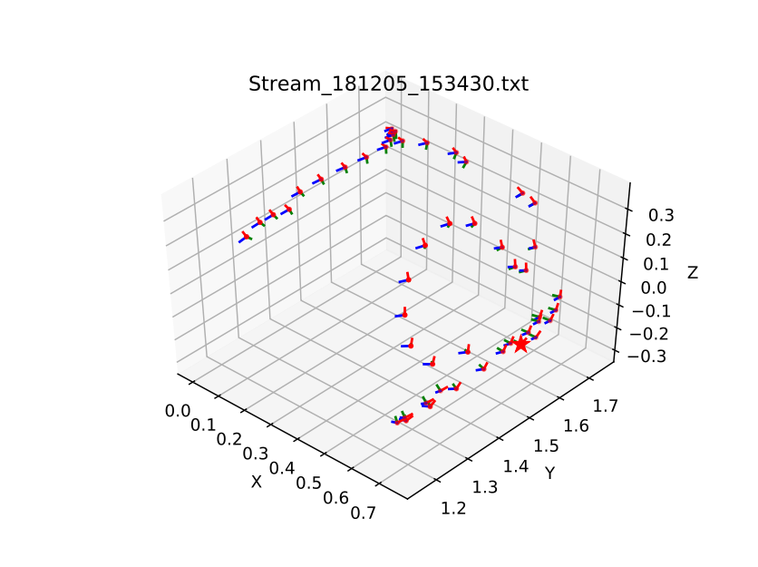
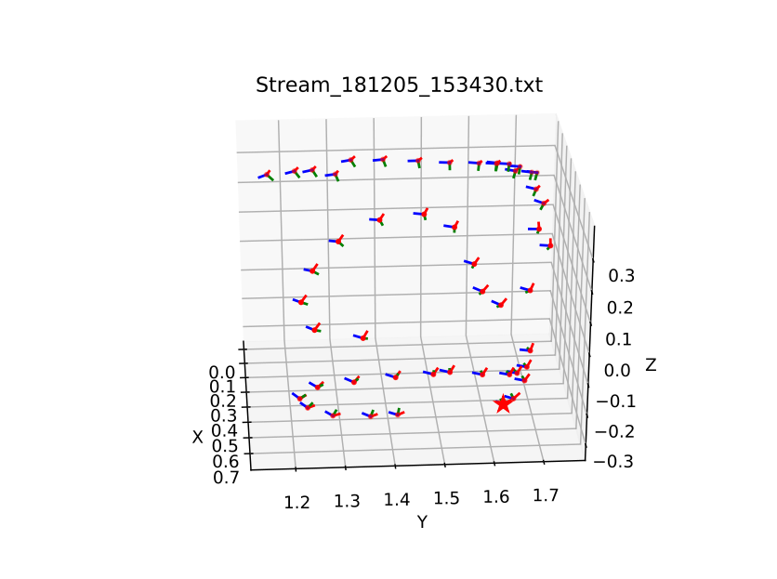
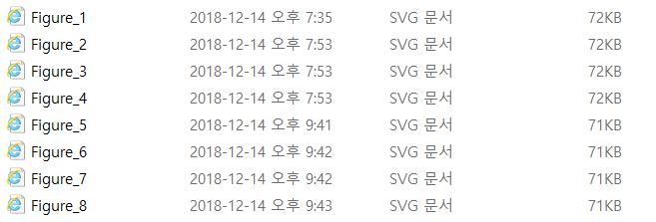
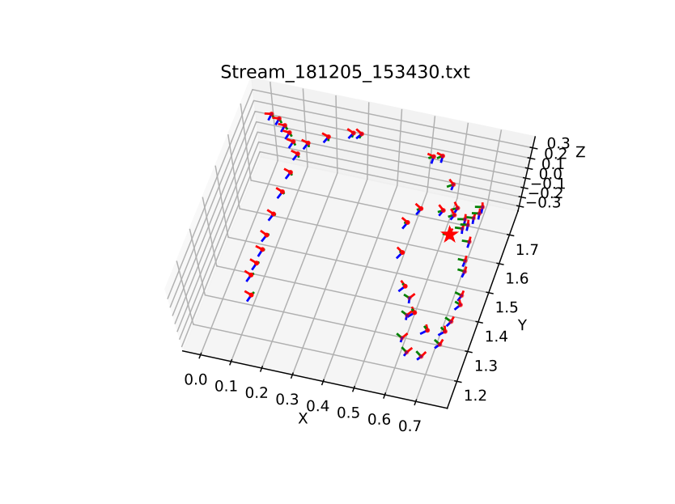
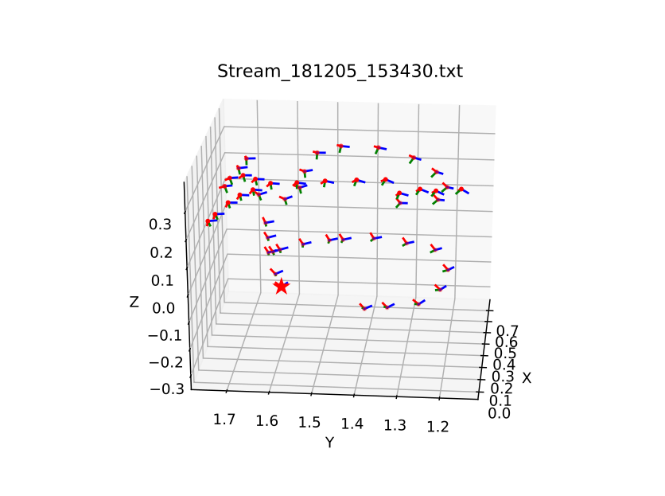
Data #1 – Visualization
다양한 각도에서 이미지 저장

Slide 8
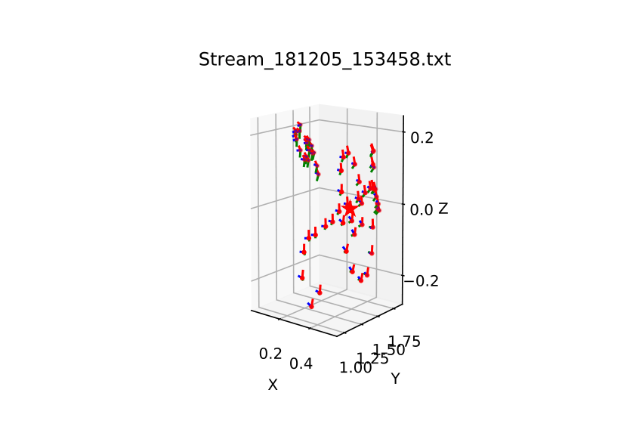
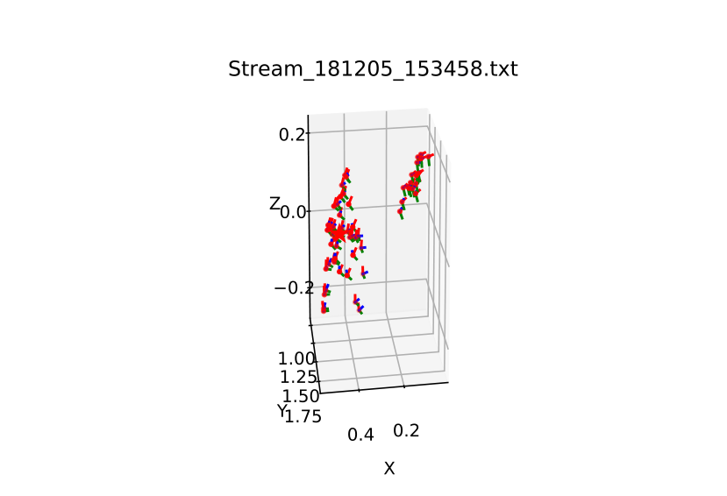
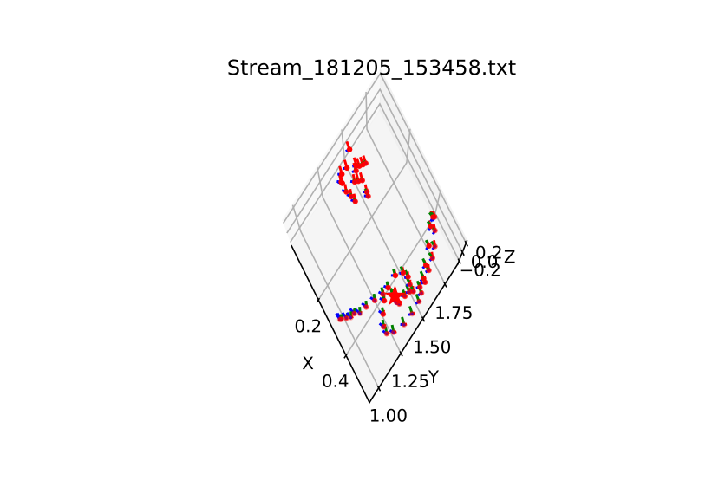
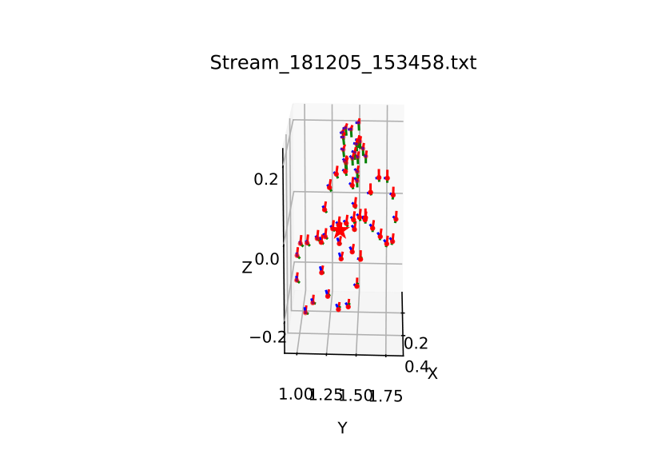
Data #2 – Visualization
다양한 각도에서 이미지 저장

Slide 9
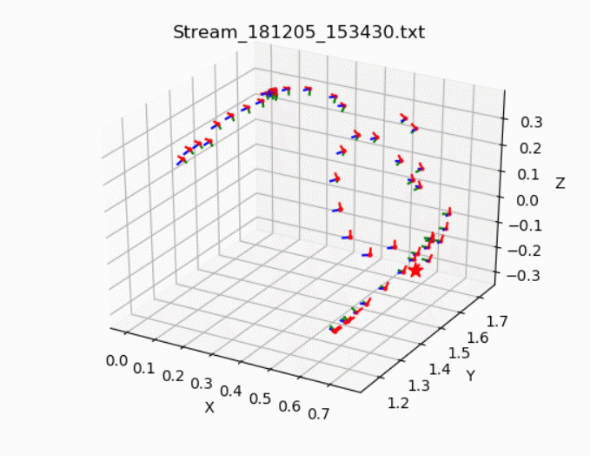
Data #1 – Visualization
동영상 캡쳐하여 저장

Slide 10
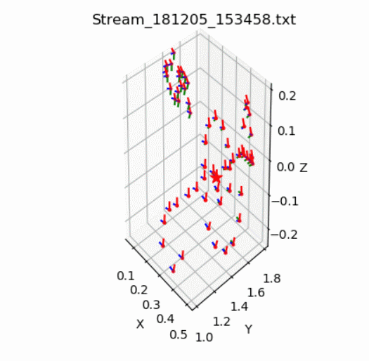
Data #2 – Visualization
동영상 캡쳐하여 저장

